Slide 1
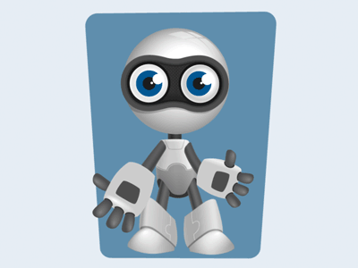
Welcome to Robotics
Where we fiddle with stuff...
in order to build stuff...
and learn stuff along the way.
2024
Edition!

Slide 2
Code of Conduct
Pass
Come to class Ready to…
fiddle, fail, try again
learn new things
apply your strengths
encourage your team mates
Respect each others ideas
No studying for other classes during Robotics
No internet use
No phones or smart watches

Slide 3
What Is A Robot?

Slide 4
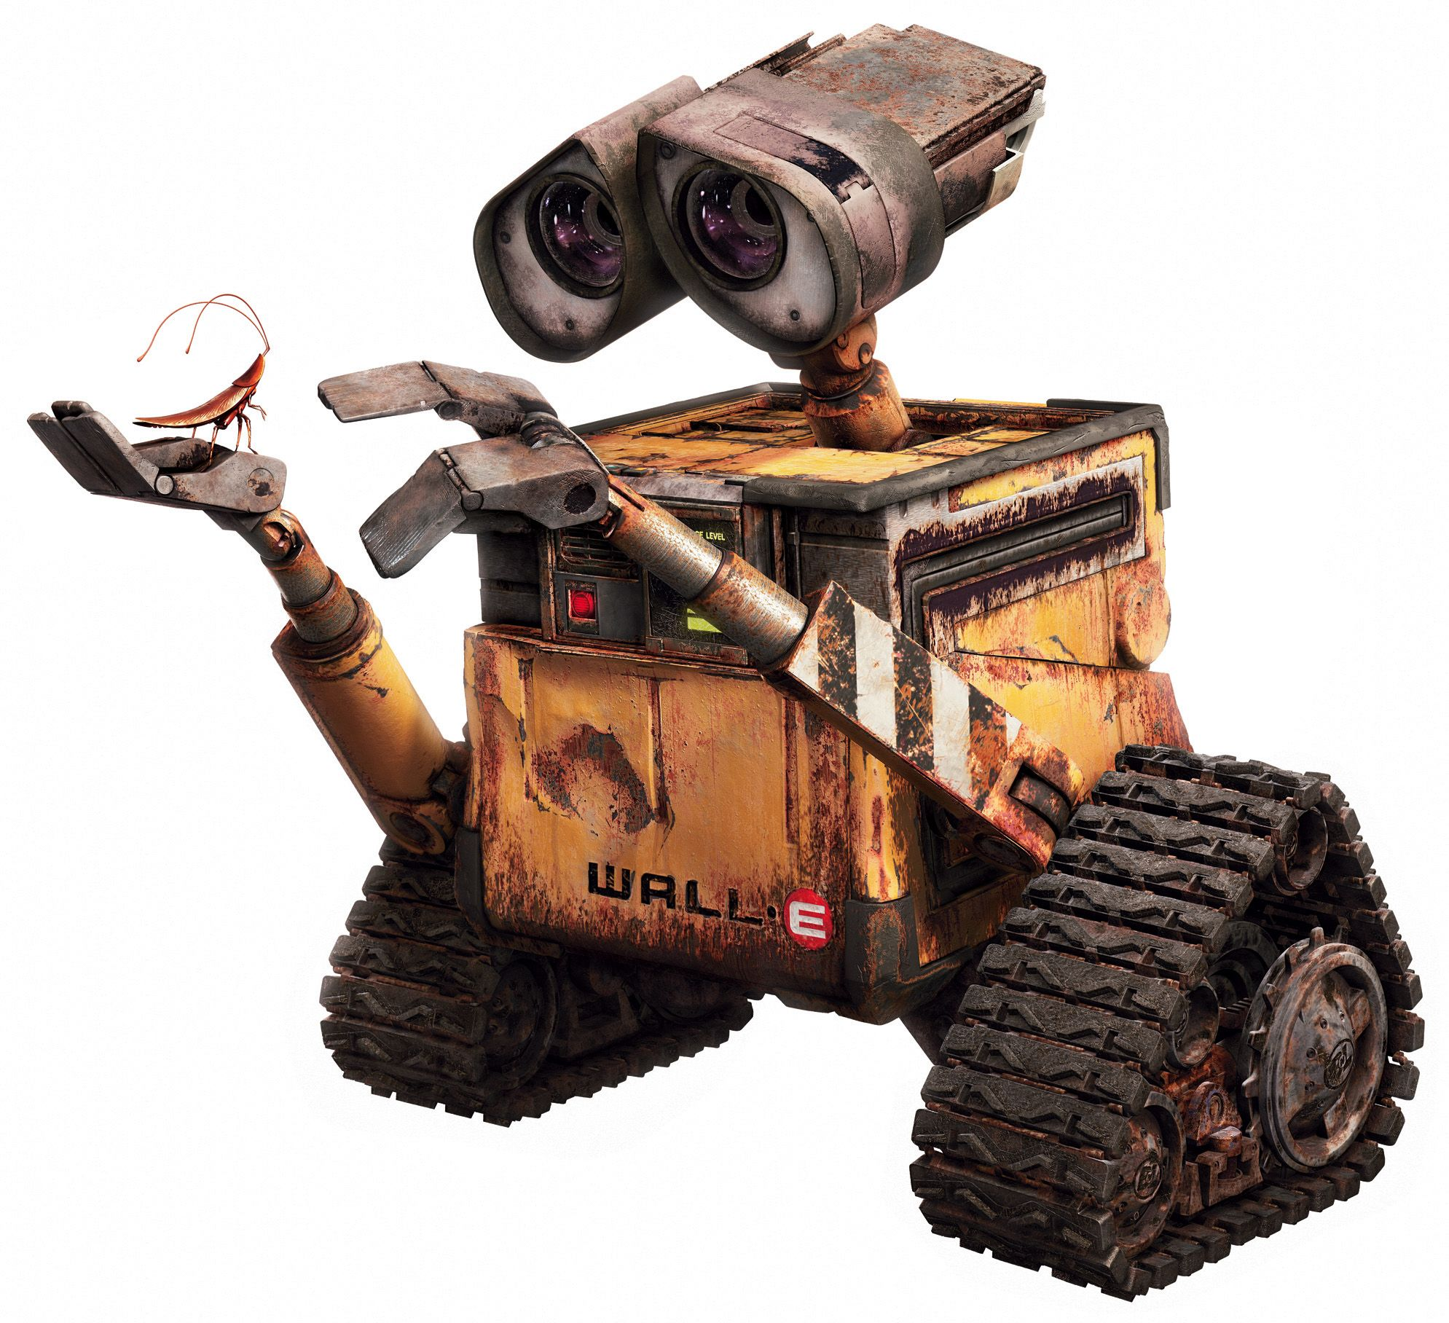
Robots Perform
Their Own Tasks

Slide 5
Mechanics
Electronics
Software
Robotics Combines All of These Disciplines
Notes:
Robotics is a discipline: engineering + computer science.
The goal of robotics: design machines that operate autonomously to perform a complex task that humans normally do. The robot should be able to help & assist the human.

Slide 6
Where are robots used & why?

Slide 7
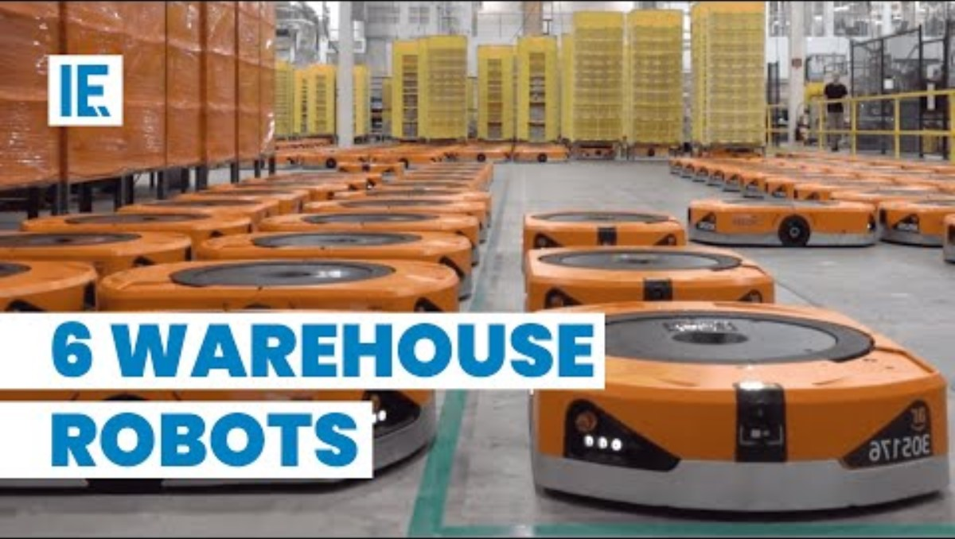

Slide 8
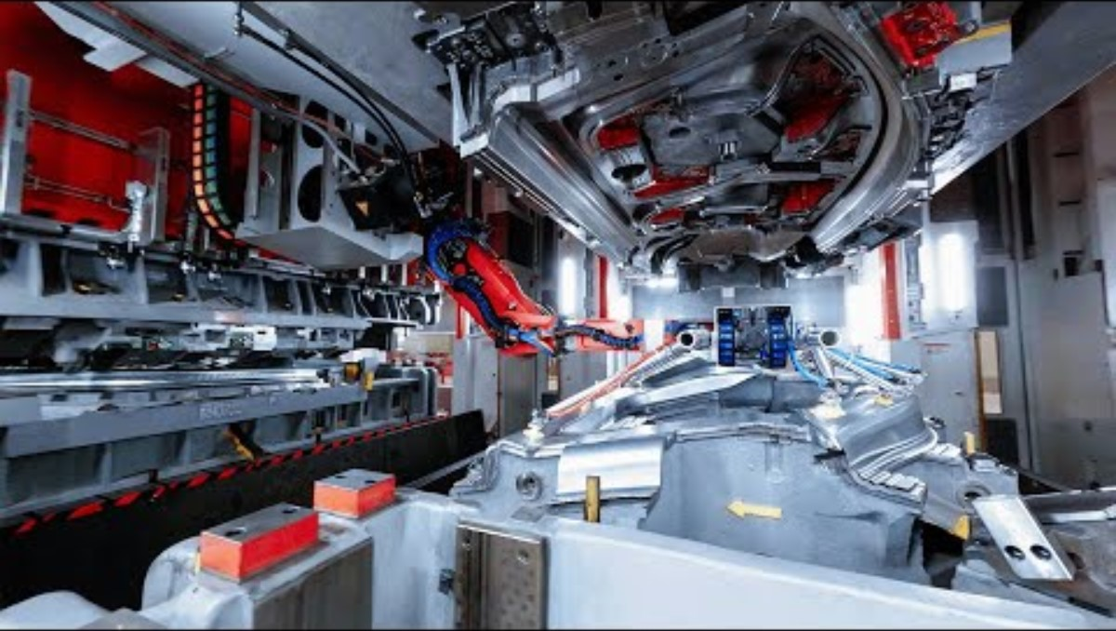
Tesla Plant Video – So Many Robots!

Slide 9
What skills are needed for building robots?

Slide 10
Course Syllabus: Manufacturing Robots
Modules
Along The Way
Manufacturing: Basic Robotic Concepts
Coordinated Complexity
Machine Learning
Raspberry Pi
Hardware Integration: Lego + Raspberry Pi
Final Challenge
2 Papers – don’t stress!
Down time happens. We’ll do fun, silly, just-because builds.
Maybe even a robot war?
Being social is expected. Talk to each other!

Slide 11
Welcome to Robotics

